Slide 1

Richter's Predictor: Modelling Earthquake Damage
Predict the level of damage to buildings caused by the 2015 Gorkha earthquake in Nepal.
The label (target) damage_grade represents the level of damage to the building.
1 - low damage
2 - medium amount of damage
3 - almost complete destruction
The label is an ordinal variable so this can be viewed as a classification or an ordinal regression problem.
Performance is measured with the ‘micro averaged F1 score’.
Rows: Train 260k, Test 87k
Data: Building location, size, design, superstructure, usage, foundations

Slide 2
The data
Features – Location, Size and Foundations
geo_level_1_id, geo_level_2_id, geo_level_3_id (type: int): geographic region in which building exists, from largest (level 1) to most specific sub-region (level 3). Possible values: level 1: 0-30, level 2: 0-1427, level 3: 0-12567.
count_floors_pre_eq (type: int): number of floors in the building before the earthquake.
age (type: int): age of the building in years.
area_percentage (type: int): normalized area of the building footprint.
height_percentage (type: int): normalized height of the building footprint.
land_surface_condition (type: categorical): surface condition of the land where the building was built. Possible values: n, o, t.
foundation_type (type: categorical): type of foundation used while building. Possible values: h, i, r, u, w.
roof_type (type: categorical): type of roof used while building. Possible values: n, q, x.
ground_floor_type (type: categorical): type of the ground floor. Possible values: f, m, v, x, z.
other_floor_type (type: categorical): type of constructions used in higher than the ground floors (except of roof). Possible values: j, q, s, x.

Slide 3
The data
Features - Superstructure
position (type: categorical): position of the building. Possible values: j, o, s, t.
plan_configuration (type: categorical): building plan configuration. Possible values: a, c, d, f, m, n, o, q, s, u.
has_superstructure_adobe_mud (type: binary): flag variable that indicates if the superstructure was made of Adobe/Mud.
has_superstructure_mud_mortar_stone (type: binary): flag variable that indicates if the superstructure was made of Mud Mortar - Stone.
has_superstructure_stone_flag (type: binary): flag variable that indicates if the superstructure was made of Stone.
has_superstructure_cement_mortar_stone (type: binary): flag variable that indicates if the superstructure was made of Cement Mortar - Stone.
has_superstructure_mud_mortar_brick (type: binary): flag variable that indicates if the superstructure was made of Mud Mortar - Brick.
has_superstructure_cement_mortar_brick (type: binary): flag variable that indicates if the superstructure was made of Cement Mortar - Brick.
has_superstructure_timber (type: binary): flag variable that indicates if the superstructure was made of Timber.
has_superstructure_bamboo (type: binary): flag variable that indicates if the superstructure was made of Bamboo.
has_superstructure_rc_non_engineered (type: binary): flag variable that indicates if the superstructure was made of non-engineered reinforced concrete.
has_superstructure_rc_engineered (type: binary): flag variable that indicates if the superstructure was made of engineered reinforced concrete.
has_superstructure_other (type: binary): flag variable that indicates if the superstructure was made of any other material.

Slide 4
The data
Features – Building Use
legal_ownership_status (type: categorical): legal ownership status of the land where building was built. Possible values: a, r, v, w.
count_families (type: int): number of families that live in the building.
has_secondary_use (type: binary): flag variable that indicates if the building was used for any secondary purpose.
has_secondary_use_agriculture (type: binary): flag variable that indicates if the building was used for agricultural purposes.
has_secondary_use_hotel (type: binary): flag variable that indicates if the building was used as a hotel.
has_secondary_use_rental (type: binary): flag variable that indicates if the building was used for rental purposes.
has_secondary_use_institution (type: binary): flag variable that indicates if the building was used as a location of any institution.
has_secondary_use_school (type: binary): flag variable that indicates if the building was used as a school.
has_secondary_use_industry (type: binary): flag variable that indicates if the building was used for industrial purposes.
has_secondary_use_health_post (type: binary): flag variable that indicates if the building was used as a health post.
has_secondary_use_gov_office (type: binary): flag variable that indicates if the building was used for a government office.
has_secondary_use_use_police (type: binary): flag variable that indicates if the building was used as a police station.
has_secondary_use_other (type: binary): flag variable that indicates if the building was secondarily used for other purposes.

Slide 5
This is a good competition for us!
Ends 31 December 2019 – 8 months! We can revisit the competition to test new techniques.
People can form teams. (Private sharing of code is not permitted.)
External data not allowed.
Data size should be manageable for laptops.
Lots of scope to feature engineer and experiment:
6 integer, 22 binary, 8 categorical
Understandable feature names and easy to relate too.
Multi-class classification or ordinal regression

Slide 6
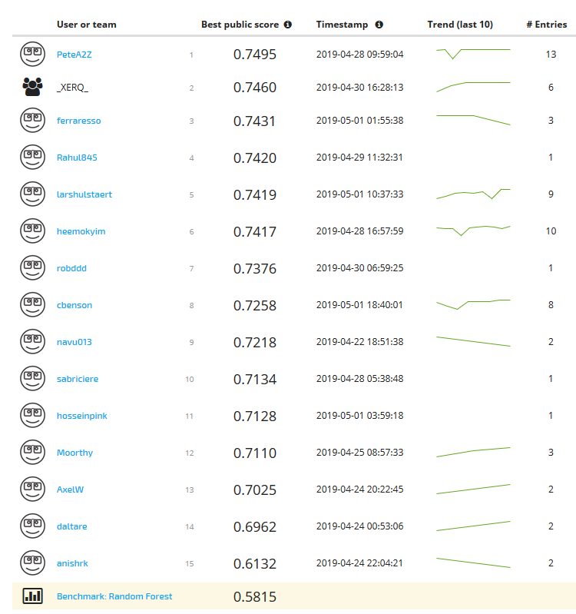

Early successes! Leaderboard Top 15 as at 2 May 2019
Robddd has thrown down the gauntlet! On 30April was 5th on the Leaderboard.

